Slide 1
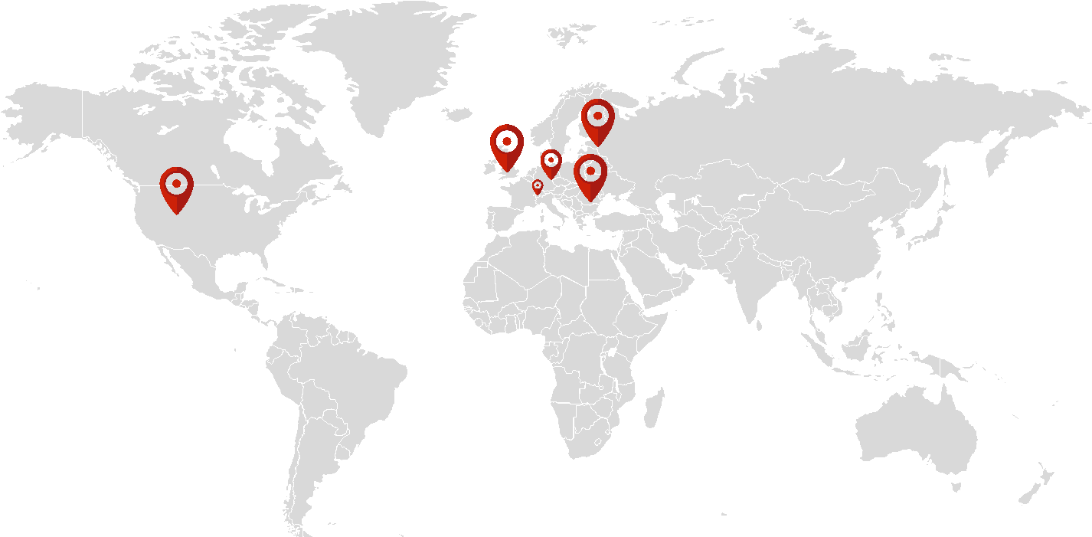


Our customers are all over the world
JAVA Training
www.zynksoftware.com
This document is strictly private, confidential and personal to its recipients and should not be copied, distributed or reproduced in whole or in part, nor passed to any third party.

Slide 2


WELCOME ABOARD!

Slide 3

WHO ARE WE?
ZYNK is a Romanian software development company specialized in building multi-platform, scalable, and innovative software products.
What makes us different?
Small enough to be AGILE, big enough to build complex projects
Successful track record of 100% delivering of offshore projects
More than 100 projects delivered
Experts all web, mobile, and platform development
Designing, building and maintaining complex, large scale, low latency, real-time or transactional systems (e.g. messaging platforms, LBS platforms, gaming platforms, highly transactional services)
Our vision
Provide affordable high quality services
Bring expertise in web, mobile and large scale distributed systems
Provide end-to-end solutions.
Quality vs. quantity
Happy customers
www.zynksoftware.com
This document is strictly private, confidential and personal to its recipients and should not be copied, distributed or reproduced in whole or in part, nor passed to any third party.

Slide 4
TRAINING PRESENTATION
Project Management Session
Android & iOS Session
Android & iOS Session
Candidates Announcement
Project Management Session: 17:00 - 19:00
iOS Session 15:00 - 17:00
Android Session 15:00 - 17:00
iOS Session 16:00 - 18:00
Android Session 16:00 - 18:00
Selected candidates will be contacted in order to proceed to the next stage
25/03 Friday
28/03 Monday
29/03 Tuesday
30/03 Wednesday
31/03 Thursday
01/04 Friday
07/04 Thursday
15/04 Friday
Opening Session
Game & Java Session
Game & Java Session
Feedback Session
Meet and Greet Session: 14:00 - 15:30
Game Session - 15:00 - 17:00
Java Session - 17:00 - 19:00
Java Session 15:00 - 17:00
Game Session 17:00 - 19:00
Feedback Session 10:00 - 12:00
www.zynksoftware.com
This document is strictly private, confidential and personal to its recipients and should not be copied, distributed or reproduced in whole or in part, nor passed to any third party.

Slide 5
TRAINING PRESENTATION
Duration: 28th March - 1st April
Assignments deadline: 7th April
Training sessions on the following technologies:
Java
Android
iOS
Game development:
Each technology will have allocated two sessions of 2h
The structure for the sessions will be:
Introduction into the basics of the technology
Demonstration of theoretical concepts implemented in an application
In order to better comprehend the assignments, we advise students to participate in both sessions for the interested technology
TRAINING
Presentation
www.zynksoftware.com
This document is strictly private, confidential and personal to its recipients and should not be copied, distributed or reproduced in whole or in part, nor passed to any third party.

Slide 6
TRAINING PRESENTATION
Our company offers internship position on the following technologies:
Java
Android
iOS
Game development
The internship is paid and has a duration of 3 months
The internships includes an introduction to technology standards, best practices and processes, mentorship from our technology leaders, working on real projects based on stakeholders’ requirements, opportunity to participate in technology guilds, certifications and tutorial courses
Extra curricular activities include: teambuilding, team outings
TRAINING
Internship Opportunity
www.zynksoftware.com
This document is strictly private, confidential and personal to its recipients and should not be copied, distributed or reproduced in whole or in part, nor passed to any third party.

Slide 7
TRAINING PRESENTATION
TRAINING
Homework Review and Candidates Selection
Deadline for submission of assignments is the 7th of April (included)
Each students shall receive a link to the ZYNK public repository from where he/she can fork the project
The homework should be completed, published to a public repository and shared the repository link with the designated OSUBB volunteer
On the 7th of April a feedback session will be held with all participants and provide feedback on the reviewed assignments
Selected candidates will be contacted by the company representative and discuss the next step in the recruitment process
www.zynksoftware.com
This document is strictly private, confidential and personal to its recipients and should not be copied, distributed or reproduced in whole or in part, nor passed to any third party.

Slide 8




WHAT ARE WE DOING?
WEB & PLATFORM DEVELOPMENT
Functional, scalable and secure, the solutions we provide can fit any industry, and they deliver high-quality web apps for companies of all sizes and business models.
Experience in building large web applications and responsive web
Architectural principles: micro services, asynchronous messaging, REST, event driven architecture, complex event processing
www.zynksoftware.com
This document is strictly private, confidential and personal to its recipients and should not be copied, distributed or reproduced in whole or in part, nor passed to any third party.

Slide 9



WHAT ARE WE DOING?
BIG DATA
Experience in building and designing large scale databases
Experience with designing Big Data platforms
Experience in web semantics and machine learning
Data warehouse design and integration
www.zynksoftware.com
This document is strictly private, confidential and personal to its recipients and should not be copied, distributed or reproduced in whole or in part, nor passed to any third party.

Slide 10
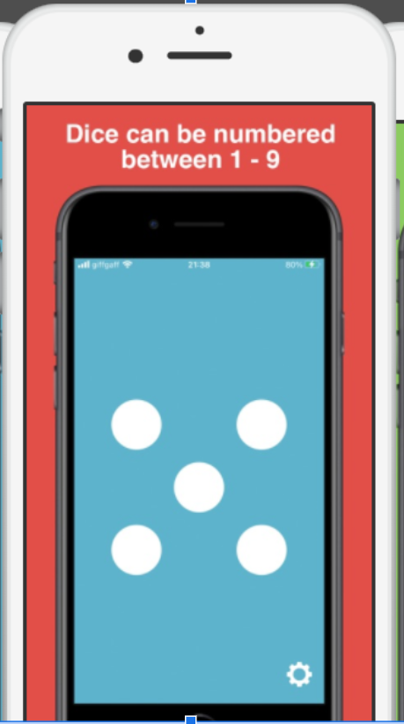
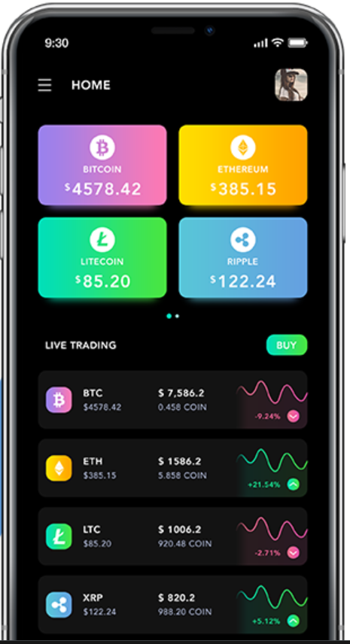
What is a backend application ? Why/When do we need it. Serverless and Serverfull applications

Slide 11
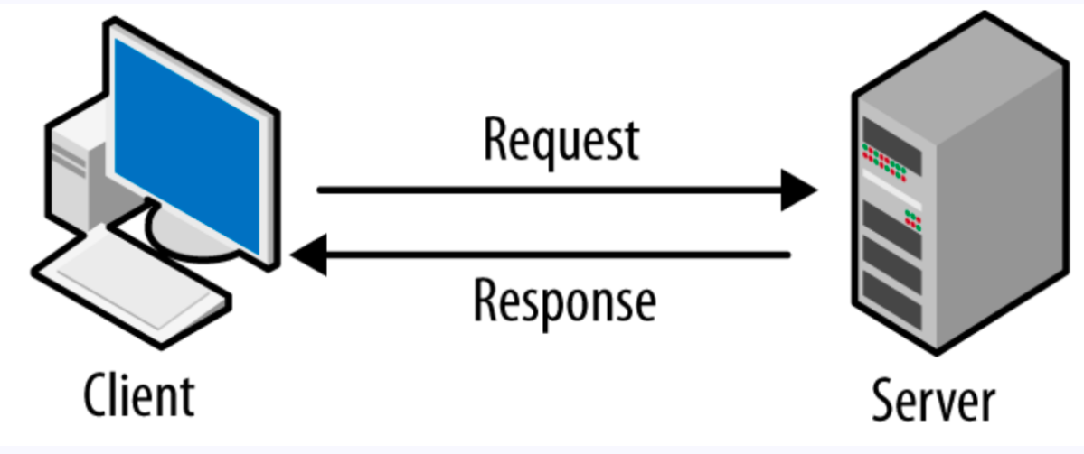
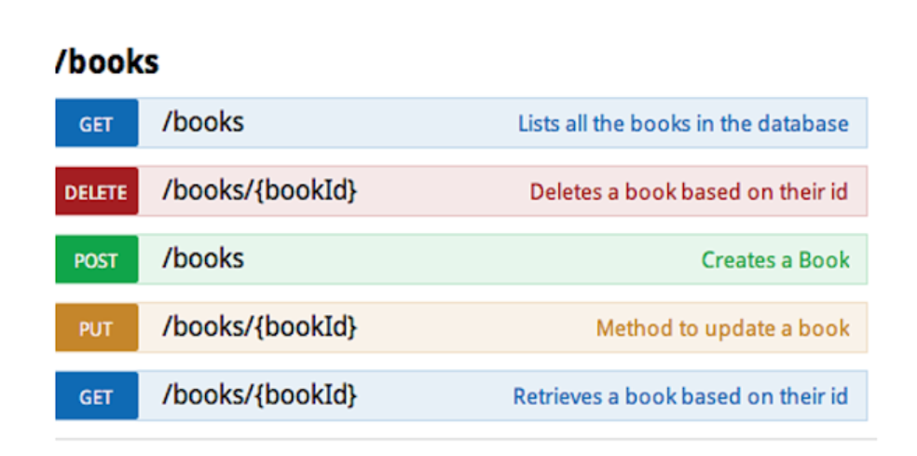
How can we communicate with a backend application.
What is HTTP?
www.zynksoftware.com
This document is strictly private, confidential and personal to its recipients and should not be copied, distributed or reproduced in whole or in part, nor passed to any third party.

Slide 12
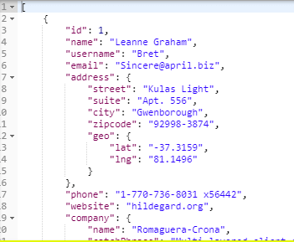
HTTP methods response
www.zynksoftware.com
This document is strictly private, confidential and personal to its recipients and should not be copied, distributed or reproduced in whole or in part, nor passed to any third party.

Slide 13
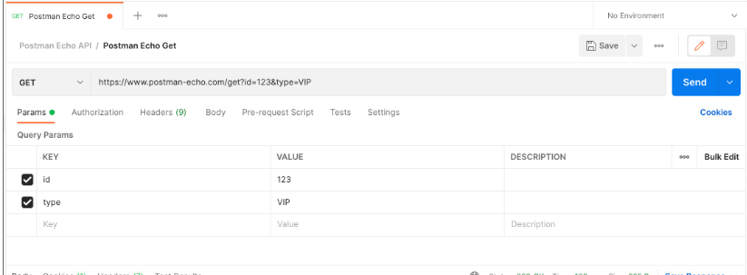
HTTP methods request
www.zynksoftware.com
This document is strictly private, confidential and personal to its recipients and should not be copied, distributed or reproduced in whole or in part, nor passed to any third party.

Slide 14
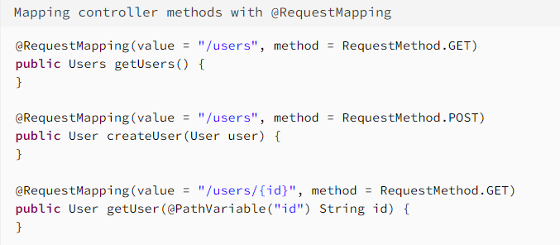
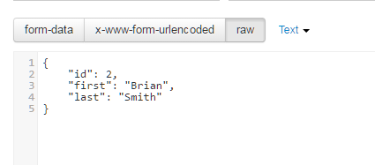
How can we communicate with a backend application.
www.zynksoftware.com
This document is strictly private, confidential and personal to its recipients and should not be copied, distributed or reproduced in whole or in part, nor passed to any third party.

Slide 15
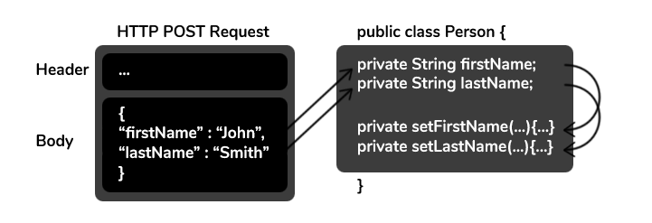
How can we communicate with a backend application.
www.zynksoftware.com
This document is strictly private, confidential and personal to its recipients and should not be copied, distributed or reproduced in whole or in part, nor passed to any third party.

Slide 16
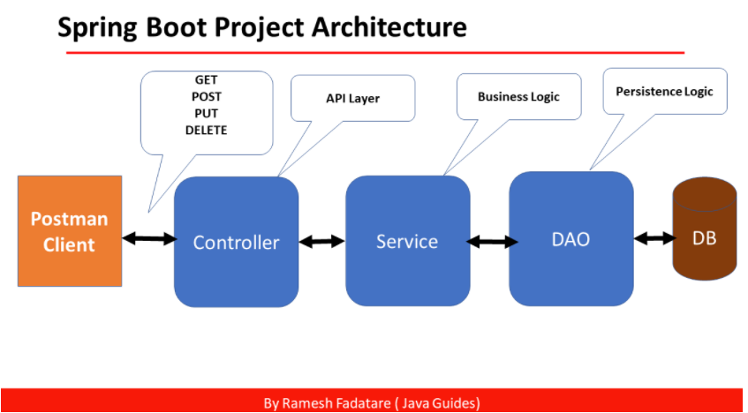
Structure of a server
www.zynksoftware.com
This document is strictly private, confidential and personal to its recipients and should not be copied, distributed or reproduced in whole or in part, nor passed to any third party.

Slide 17
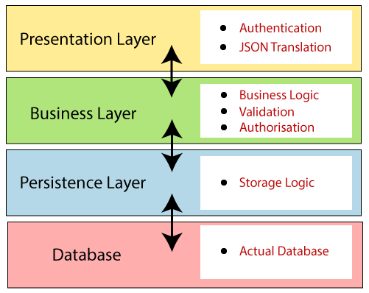
Layer’s functional role
www.zynksoftware.com
This document is strictly private, confidential and personal to its recipients and should not be copied, distributed or reproduced in whole or in part, nor passed to any third party.

Slide 18
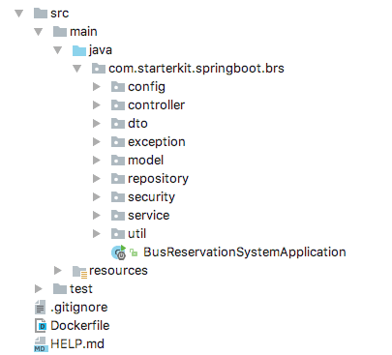
Packet structure of a server
www.zynksoftware.com
This document is strictly private, confidential and personal to its recipients and should not be copied, distributed or reproduced in whole or in part, nor passed to any third party.

Slide 19
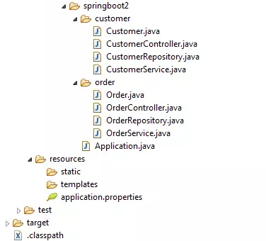
Packet structure of a server
www.zynksoftware.com
This document is strictly private, confidential and personal to its recipients and should not be copied, distributed or reproduced in whole or in part, nor passed to any third party.

Slide 20
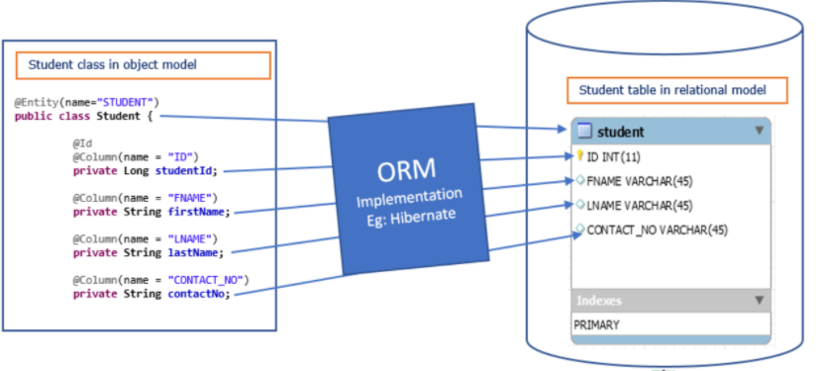
Object relational mapping Hibernate
www.zynksoftware.com
This document is strictly private, confidential and personal to its recipients and should not be copied, distributed or reproduced in whole or in part, nor passed to any third party.

Slide 21
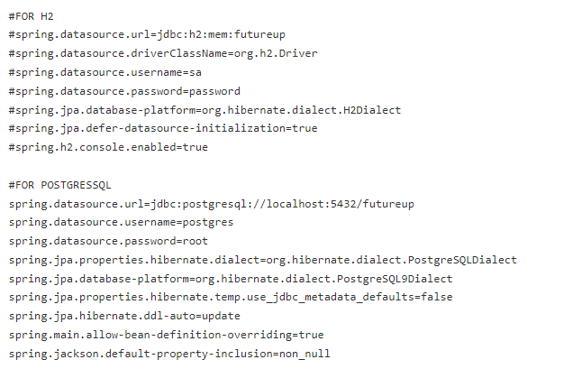
Automatic orm. application.properties file
www.zynksoftware.com
This document is strictly private, confidential and personal to its recipients and should not be copied, distributed or reproduced in whole or in part, nor passed to any third party.

Slide 22
Thank you, next session Thursday, 31 March at 15:00
www.zynksoftware.com
This document is strictly private, confidential and personal to its recipients and should not be copied, distributed or reproduced in whole or in part, nor passed to any third party.

Slide 23
Biografie:
https://spring.io/quickstart
https://www.sourcecodeexamples.net/2021/08/spring-boot-project-with-controller.html
https://howtodoinjava.com/spring5/webmvc/controller-getmapping-postmapping/
Hello world tutorial: https://www.youtube.com/watch?v=CX-xBVIEIkw
Github with project:
https://github.com/zynkware/training-futureup-java
www.zynksoftware.com
This document is strictly private, confidential and personal to its recipients and should not be copied, distributed or reproduced in whole or in part, nor passed to any third party.

